Slide 1
GROUP 9
NAME | REG.NO | STUDENT NO.
SEMPA ETHAN IAN | 16/U/11403/PS | 216004900
KWESIGA PETER | 16/U/6411/EVE | 216002578
NABAGIDDE GRACE DIANA | 16/U/8005/PS | 216012180
BWIRE IVAN | 16/U/4522/PS

Slide 2
NEURAL NETWORKS
A neural network is an interconnected assembly of simple processing elements, units and nodes, whose functionality is loosely based on the animal neuron.
It is based on a collection of nodes(artificial neurons) with each connection between the artificial neurons transmitting a signal. The neuron that receives the signal processes it and then signals neighboring neurons.
The processing ability of the network is stored in the interunit connection strengths, or weights, obtained by a process of adaptation to, or learning from, a set of training patterns.

Slide 3
HOW THE HUMAN BRAIN WORKS
A neuron collects signals from others through a host of fine structures called dendrites. The neuron sends out spikes of electrical activity through the axon.
At the end of each branch, a structure called a synapse that converts the activity from the axon into electrical effects that inhibit or excite activity from the axon into electrical effects that inhibit or excite activity in the connected neurons.
When a neuron receives excitatory input that is sufficiently large compared with its inhibitory input, it sends a spike of electrical activity down its axon.

Slide 4
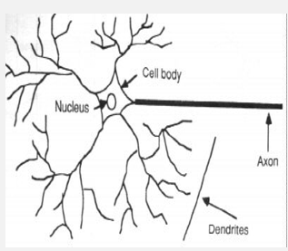
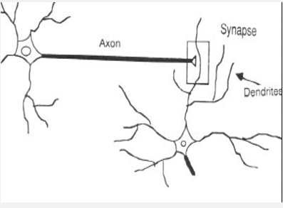
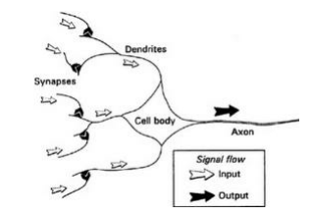
How does the human brain learn?

Slide 5
A simple artificial neuron
An artificial neuron is a device with many inputs and one output. The neuron has two modes of operation; the training mode and the using mode
In the training mode, the neuron can be trained to fire (or not), for particular input patterns. In the using mode, when a taught input pattern is detected at the input, its associated output becomes the current output. If the input pattern does not belong in the taught list of input patterns, the firing rule is used to determine whether to fire or not.

Slide 6
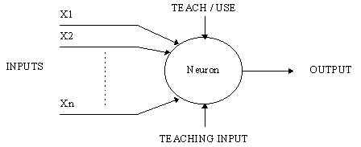
A simple artificial neuron

Slide 7
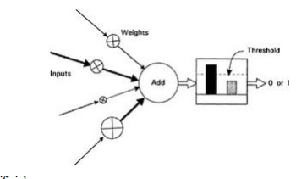
ARTIFICIAL NEURAL NETWORK
This is a computational system inspired by the Structure, processing method and learning ability of a biological brain.
An ANN is configured for a specific application, such as pattern recognition or data classification, through a learning process.
ELEMENTS OF ARTIFICIAL NEURAL NETWORKS
Processing Units
Topology
Learning Algorithm

Slide 8
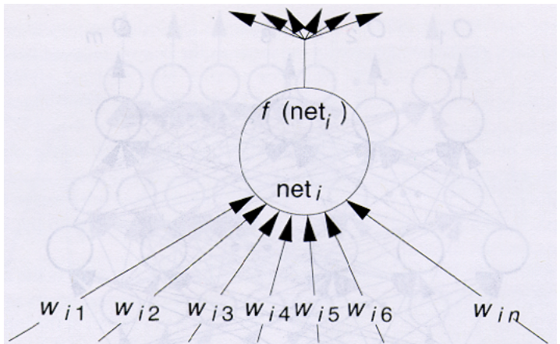
PROCESSING UNITS
Node input: net_{i} =Σ_{j}w_{ij}I_{i} Node Output: O_{i} = f (net_{i})

Slide 9
Perceptron
A perceptron, viz. single layer neural network, is the most basic form of a neural network. A perceptron receives multidimensional input and processes it using a weighted summation and an activation function.
It is trained using a labeled data and learning algorithm that optimize the weights in the summation processor.
A major limitation of perceptron model is its inability to deal with non-linearity. A multilayered neural network overcomes this limitation and helps solve non-linear problems
The learning rules can be used in conjunction with backpropgation error method.

Slide 10
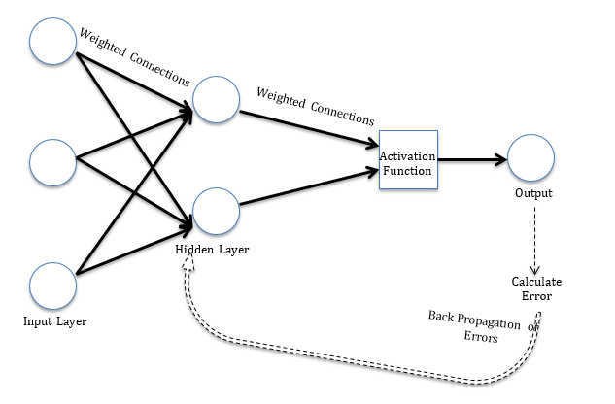
Perceptron

Slide 11
LEARNING ALGORITHM
ACTIVATION FUNCTION
It calculates the weighted sum and adds direction and decides whether to fire a particular neuron or not.
SIGMOID OR LOGISTIC FUNCTION
This is an activation function where it scales thee values between 0 & 1 by applying a threshold.
Sigmoid functions and their combinations usually work better for classification techniques e.g. Binary Classification 0s and 1s.
It can cause a neural network to get stuck at the training time.

Slide 12
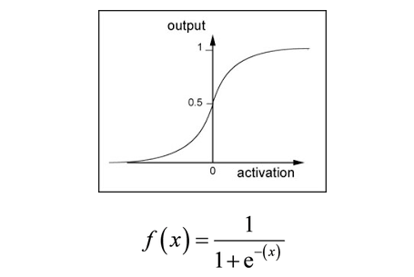

Slide 13
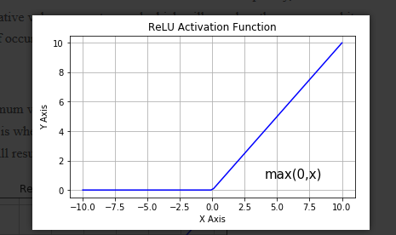
ReLU(Rectified Linear Unit) :
This is one of the most widely used activation function. The benefits of ReLU is the sparsity, it allows only values which are positive and negative values are not passed which will speed up the process and it will negate or bring down possibility of occurrence of a dead neuron.
ReLU is a widely used activation function and yields better results compared to Sigmoid and Tan

Slide 14
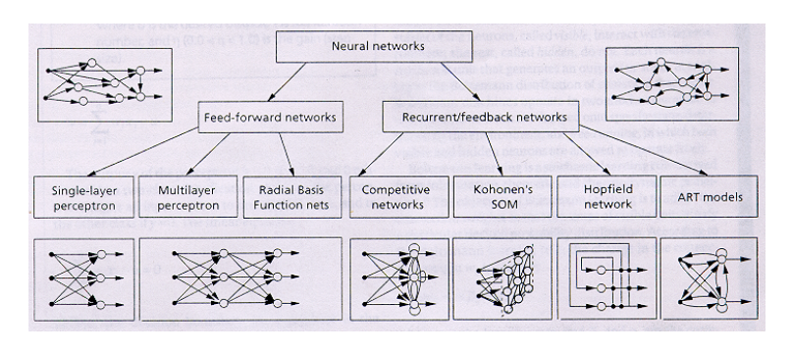
TOPOLOGY

Slide 15
Why use neural networks?
Ability to learn how to do tasks based on data given for training or initial experience/ No need to program neural networks since they learn with examples.(adaptive learning)
Neural Network computations can be carried out in parallel offering real time operation thus more advantageous in terms of speed.
They help us to find a solution where algorithmic methods are computationally intensive or don’t exist. OR They can be used to extract patterns and detect trend too complex to be noticed by either humans or other computational techniques e.g. Vision processing, Time series forecast.
Fault tolerance: Partial destruction of a network leads to the corresponding degradation of performance. However, some network capabilities may be retained even with major network damage.

Slide 16
Characteristics of Artificial neural network
A large number of very simple processing neuron-like processing elements.
A large number of weighted connections between the elements.
Distributed representation of knowledge over the connections
Knowledge is acquired by network through a learning process.

Slide 17
Conventional computer vs Neural Network
Conventional computers use an algorithmic approach i.e. they follow a set of instructions to solve a problem they understand and know how to solve. Their solution is totally predictable and if anything goes wrong, it is either a hardware or software problem.
Neural networks learn by example similar to a brain and are not programmed to solve a specific task. The network finds out how to solve a problem on its own and its operation is unpredictable.
Neural networks offer significant speed advantage over conventional techniques because neurons work in parallel to solve a specific problem.
However, these two are not in competition but complement each other. There are tasks are more suited to an algorithmic approach like arithmetic operations and likewise for neural networks. Even more, a large number of tasks, require systems that use a combination of the two approaches (normally a conventional computer is used to supervise the neural network) in order to perform at maximum efficiency.

Slide 18
Applications of neural networks
Character recognition: Has become really vital because it is used to recognize handwritten characters such as on receipts, invoices, cheques or legal billing.
Finger print recognition: Since finger prints are a unique pattern of ridges and valley’s for every person and the probability of two of them being alike is 1 in 1.9x10^15, this system is used in recognition of criminals, provision of security to cars, phones, banks, government elections to prove valid voters.
Spell check: Neural networks have been incorporated in many text editors to find out misspelled words and help rectify them.

Slide 19
More applications….
Text classification: Neural networks are widely used in applications like web searches, language identification to predict words or sentences based on the character-level inputs and abstract text context.
Stock market prediction: Many factors determine whether a given stock will go up or down on a given day and since neural networks can examine a lot of information quickly and sort it all out, they can be used to predict stock prices.
Data validation: Checks for the integrity and validity of data being inputted to different software and its components through the training, validation and test datasets as applied to Microsoft Excel.

Slide 20
Shortcomings of neural networks
Black box: Due to its unpredictability, it’s not used in some systems like banks to predict whether a person is creditworthy because there is need to explain to their customers why they don’t get a loan so as not to lose customers.
Duration of development: Tensorflow library is used when for instance you are trying to solve a difficult problem that no one has ever done before but it is more complicated and takes longer thus becoming costly.

Slide 21
More shortcomings….
Amount of data: Neural networks require much more data than traditional algorithms yet many problems can be solved well with less data incase you use the other algorithms.
Computationally expensive: Successful training of really deep neural networks can take several weeks to train completely from scratch, however, traditional algorithms take less time ranging from minutes to hours or days. The amount of computational power needed for a neural network depends heavily on the size of your data but also on how deep and complex your network is.

Slide 22
Types of Neural Networks
Feed Forward Neural Networks
Recurrent Neural Networks
Radial Basis Neural Networks
Kohonen Self-Organizing Neural Networks
Modular Neural Networks
Physical Neural Network

Slide 23
Feed Forward Neural Network
-Data/input moves in one direction only that is to say from the input nodes to the output nodes passing through the hidden layer(s) if any.
-Has no cycles/loops
Single layer perceptron neural network
-Consists of a single layer of output nodes; the inputs are fed directly to the outputs via a series of weights.
-The sum of the products of the weights and the inputs is calculated in each node, and if the value is above some threshold (typically 0) the neuron fires and takes the activated value (typically 1); otherwise it takes the deactivated value (typically -1).

Slide 24
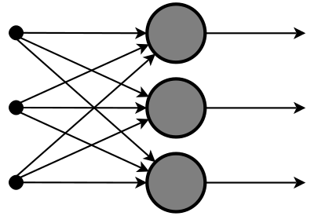
Feed Forward Neural Network
Application
-Found in computer vision and speech recognition where classifying the target classes are complicated.

Slide 25
Recurrent Neural Networks
Allows for a bi-directional flow of data unlike the Feed Forward Neural Network.
Works on the principle of saving the output of a layer and feeding this back to the input to help in predicting the outcome of the layer.
First layer is formed similar to the feed forward neural network with the product of the sum of the weights and the features.
Neuron will remember some information it had in the previous time-step.
If the prediction is wrong we use the learning rate or error correction to make small changes so that it will gradually work towards making the right prediction during the back propagation.

Slide 26
Recurrent Neural Networks
Application
Text to speech conversion

Slide 27
Other Types
Radial Basis Neural Network:
Consider the distance of a point with respect to the center. The model depends on the maximum reach or the radius of the circle in classifying the points into different categories.
Kohonen Self Organizing Neural Network:
-input vectors of arbitrary dimension to discrete map comprised of neurons and train the map to create an organization of the training data.
Modular Neural Network:
-Collection of different networks working independently and contributing towards the output.
Physical Neural Network:
-An electrically adjustable resistance material is used for emulating the function of a neural synapse. While the physical hardware emulates the neurons, the software emulates the neural network.

Slide 28
The Learning Process
The memorization of patterns and subsequent response of a network can be divided in two paradigms;
Associative Mapping : network learns to produce a particular pattern on the set of input units whenever another particular pattern is applied on the set of input units.
It is further divided into two mechanisms namely;
Auto-association: This is used to provide pattern completion, i.e. to produce a pattern whenever a portion of it or a distorted pattern is presented.
Hetero-association: The network actually stores pairs of patterns building an association between two sets of patterns and is is related to two recall mechanisms.

Slide 29
The Learning Process
-nearest-neighbor: where the output pattern produced corresponds to the input pattern stored, which is closest to the pattern presented.
-interpolative: where the output pattern is a similarity dependent interpolation of the patterns stored corresponding to the pattern presented.
2. Regularity detection : In which units learn to respond to particular properties of the input patterns.
-Whereas in associative mapping the network stores the relationships among patterns, in regularity detection the response of each unit has a particular 'meaning’.

Slide 30
The Learning Process
Learning Methods
Supervised learning
Unsupervised learning
Transfer Function
Behavior of a neural network depends on both the weights and the transfer function i.e. input output function that is specified for the units. There are three categories of transfer functions;
Linear; output activity is proportional to the total weighted output.
Threshold ; Output is set as one of two values, depending on whether the total output is less than or greater than some threshold value.
Sigmoid; Output varies continuously but not linearly as the input changes.

Slide 31
The Learning Process
Procedure for learning for 3-layer network
We present the network with training examples, which consist of a pattern of activities for the input units together with the desired pattern of activities for the output units.
We determine how closely the actual output of the network matches the desired output.
We change the weight of each connection so that the network produces a better approximation of the desired output.

Slide 32
The Learning Process
Example
*Network that recognizes hand written digits.
-If we have an array of 256 sensors each recording the presence or absence of ink in a small area of a digit then we need 256 input units and 10 output units and a number of hidden units.
-To train the network, we present an image of a digit and compare the actual activity of the 10 output units with the desired activity.
-We then calculate the error between the desired and actual activities.
-The weights of each connection are changed to reduce the error.
-This is implemented by calculating the error derivative and perturbing the weight slightly and seeing how the error changes.
-It can also be implemented using the back propagation algorithm.

Slide 33
Back propagation Algorithm
We must adjust the weights of each unit in such a way that the error between the desired output and the actual output is reduced. This process requires that the neural network compute the error derivative of the weights.(EW)
Each error derivative is calculated by computing the rate at which the error changes as the activity level of a unit is changed(EA) and for output units, this is the difference of the actual and desired output.
To get the EA of a hidden unit, identify all the weights between that hidden unit and the output units to which it is connected.
Multiply those weights by the EAs of those output units and add the products. This sum is the EA of the hidden unit.
Calculate all EAs in the hidden layer and compute EAs for other layers moving in a direction opposite to the way activities propagate through a network.

Slide 34
Back propagation Algorithm
Hence the name back propagation.
EW is the product of the EA and the activity through an incoming connection.

